Slide 1

Ghostbusters and Ghosts
Carlos Moreno
#106787596

Slide 2
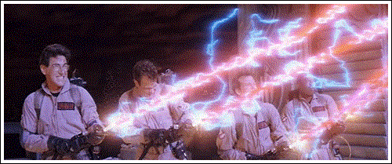
Problem Description
A group of n Ghostbusters is battling n ghosts
Each Ghostbuster carries a proton pack that can shoot a stream, destroying the ghost
Ghostbusters’ winning strategy:
Pair off with a ghost (forming n Ghostbuster-ghost pairs)
Simultaneously, each Ghostbuster will shoot a stream
However, they must pick pairings in such a way that the streams do NOT cross

Slide 3
Assumptions
The position of each Ghostbuster and each ghost is a fixed point
No 3 positions are colinear

Slide 4
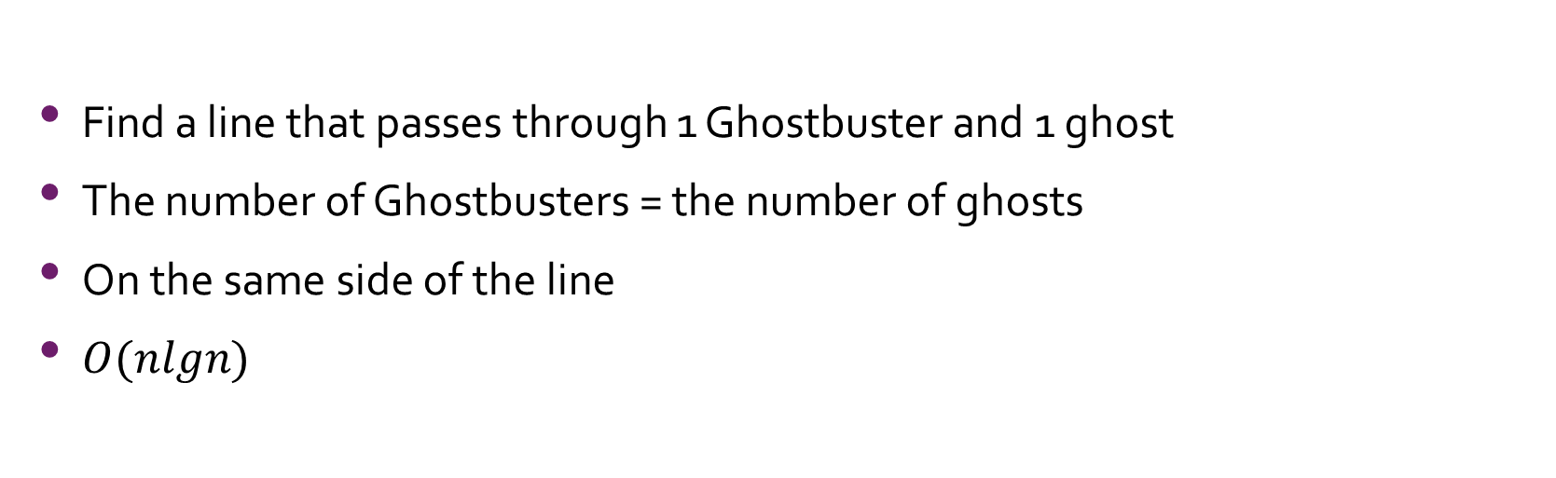
Part A
Find a line that passes through 1 Ghostbuster and 1 ghost
The number of Ghostbusters = the number of ghosts
On the same side of the line
$O(nlgn)$

Slide 5
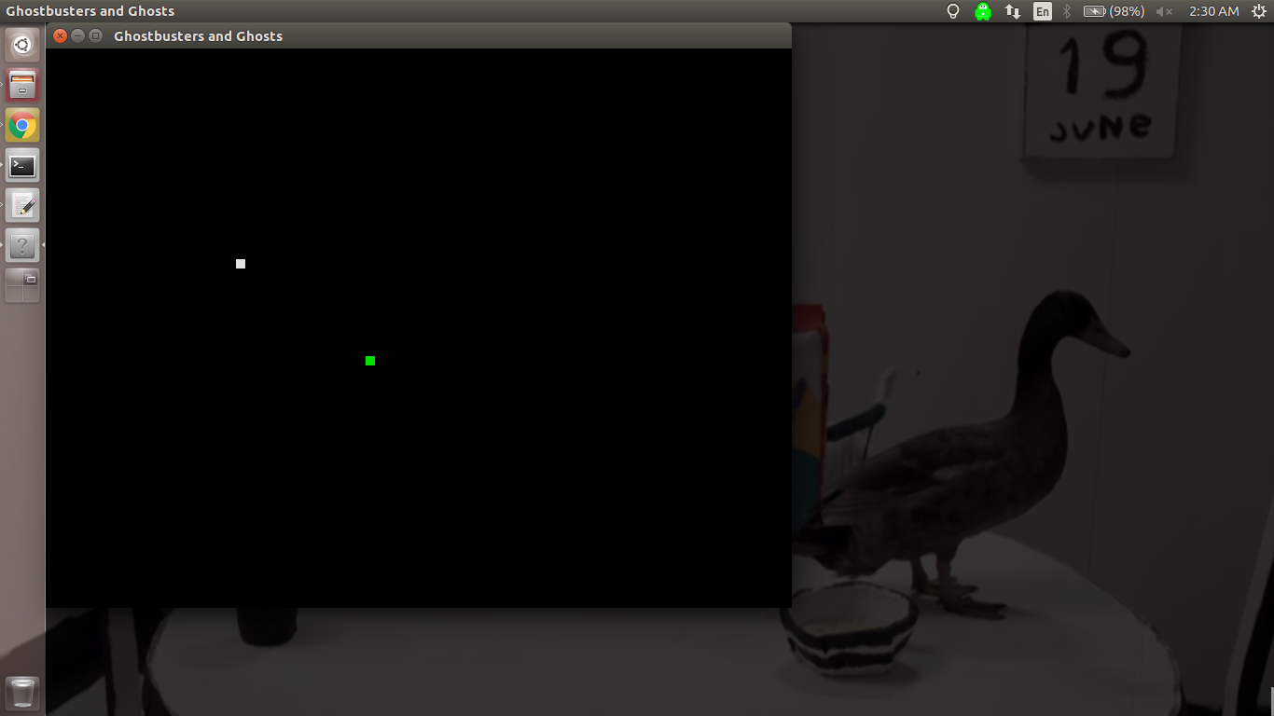
n = 1

Slide 6
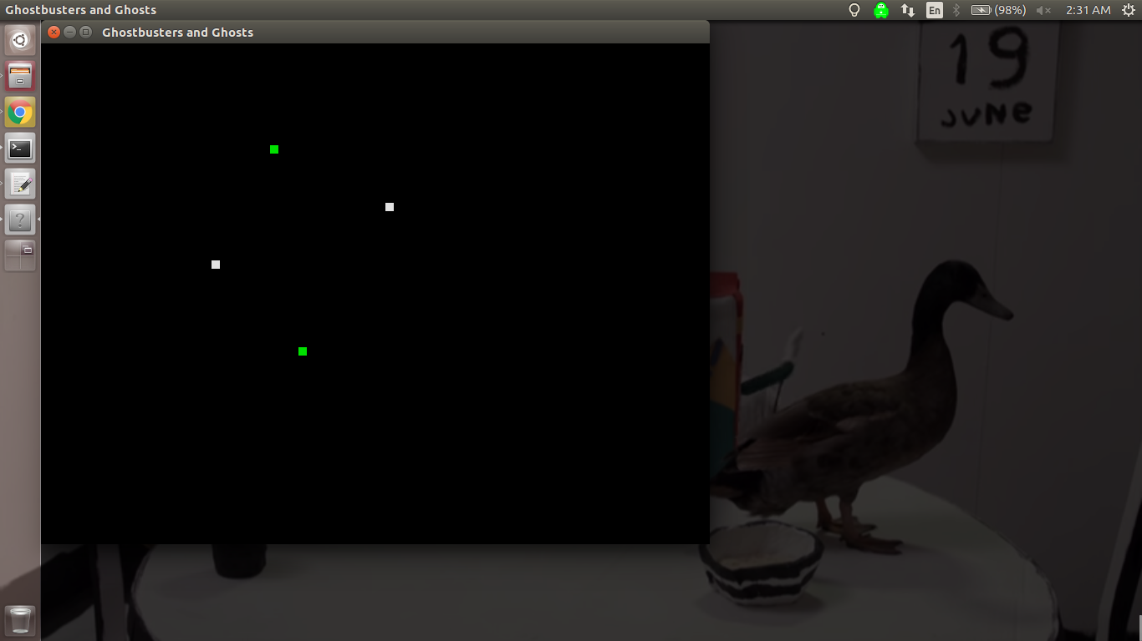
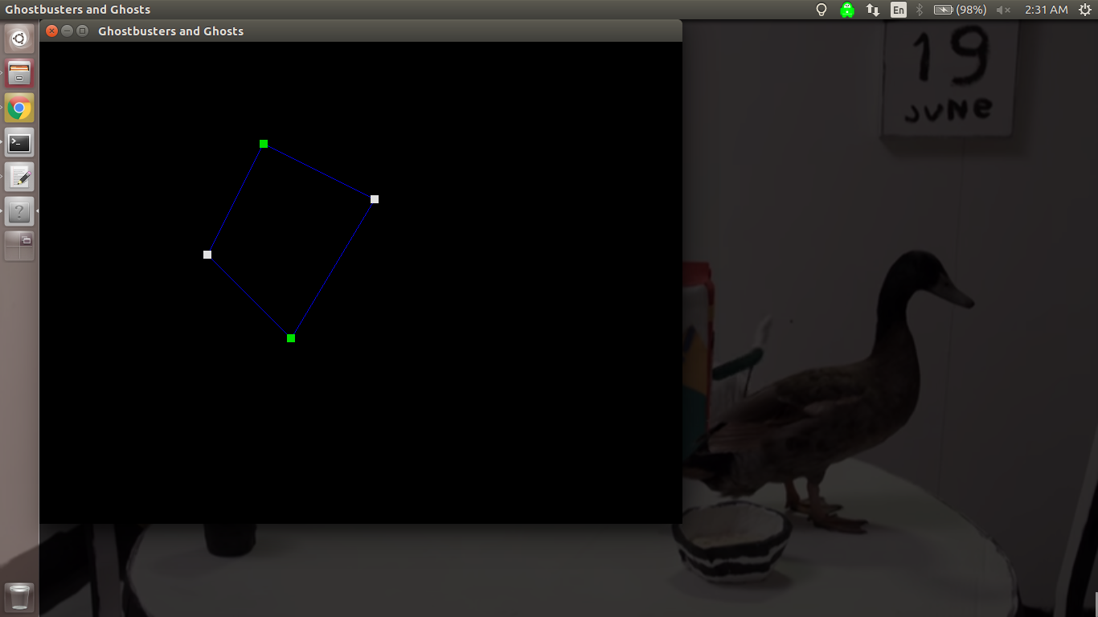
n = 2

Slide 7

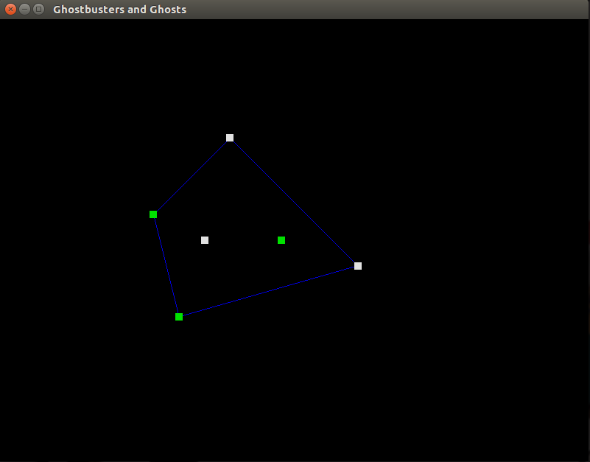
n = 3

Slide 8
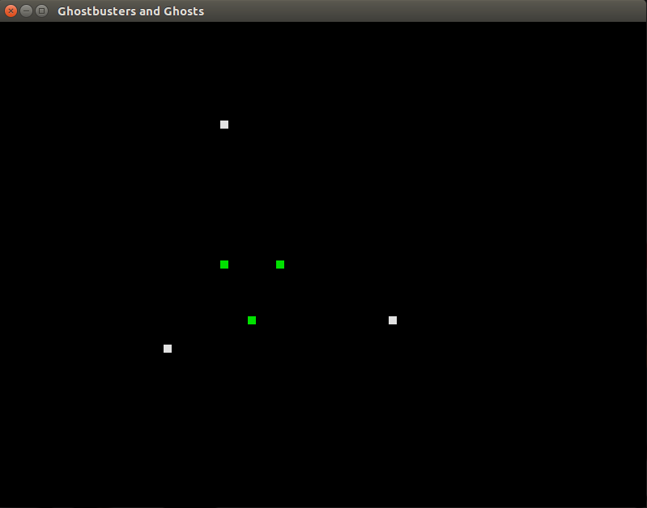

Completely Surrounded Case

Slide 9

Pseudocode and (Worst Case) Analysis
findLine(busters, ghosts, n) // base case if (n == 1) return (0,0) // normal case convHull <- grahamsScan(busters, ghosts, n) for (each edge pair in convHull) if (edge pair consists of a Ghostbuster and ghost) return (busterIndex, ghostIndex) // completely surrounded case v <- pick any vertex in convHull for (each point p not in the convHull) if (the number of Ghostbusters-ghosts on the same side of the line formed by (v,p) is equal) return (vIndex, pIndex)
$$O(n^{2})$$
// // // C1 // // // nlgn // 2n // C2 // C3 // // // C4 // n // 2n-2 // // C3

Slide 10
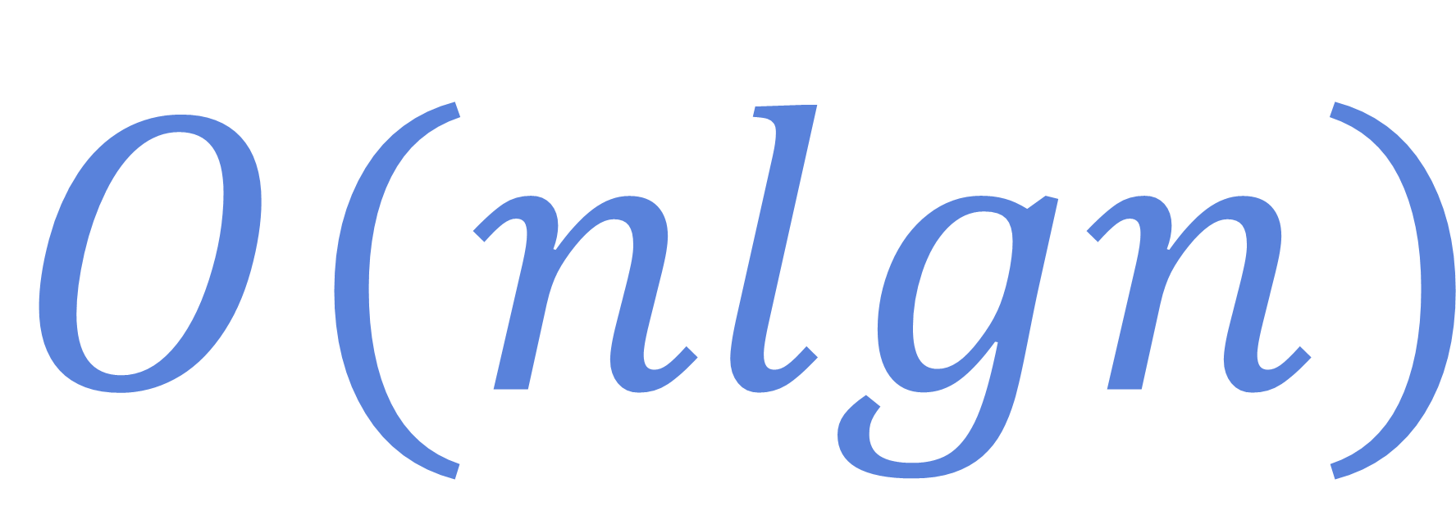
Pseudocode and (Worst Case) Analysis -Multithreaded-
findLineThread(busters, ghosts, n) // base case if (n == 1) return (0,0) // normal case convHull <- grahamsScan(busters, ghosts, n) for (each edge pair in convHull) if (edge pair consists of a Ghostbuster and ghost) return (busterIndex, ghostIndex) // completely surrounded case v <- pick any vertex in convHull for (each point p not in the convHull) create and dispatch thread to calculate the numbers for line (v,p) for (each thread dispatched) if (same number of Ghostbusters and ghosts on the same side) return (bIndex, gIndex)
// // // C1 // // // nlgn // 2n // C2 // C3 // // // C4 // n // C5 // n // C6 // C3
$$O(nlgn)$$

Slide 11
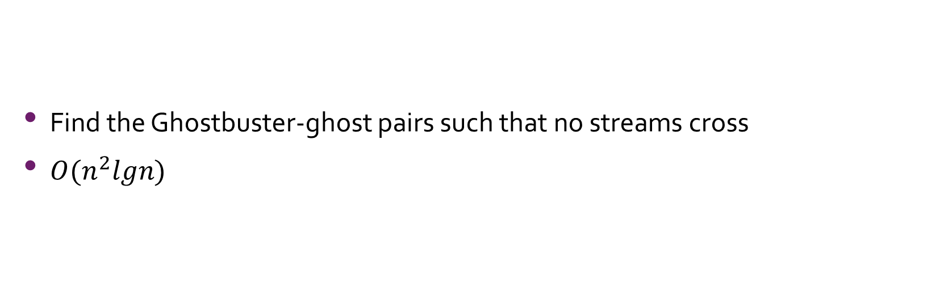
Part B
Find the Ghostbuster-ghost pairs such that no streams cross
$O(n^{2}lgn)$

Slide 12
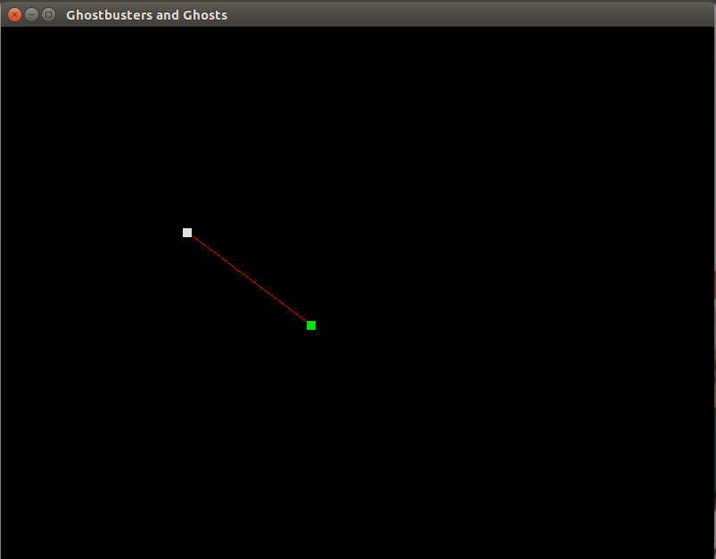
n = 1

Slide 13
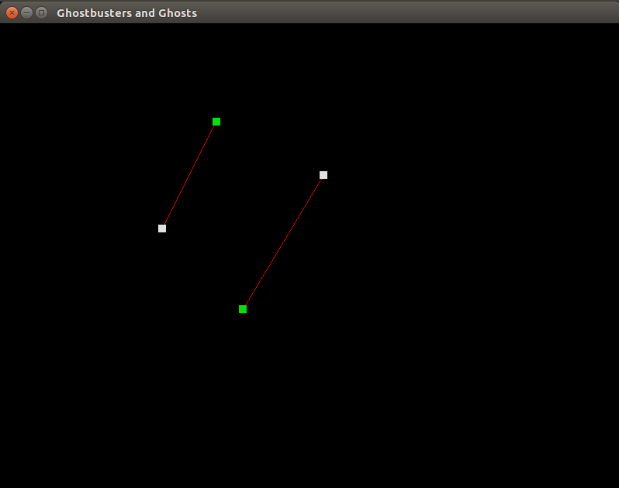
n = 2

Slide 14
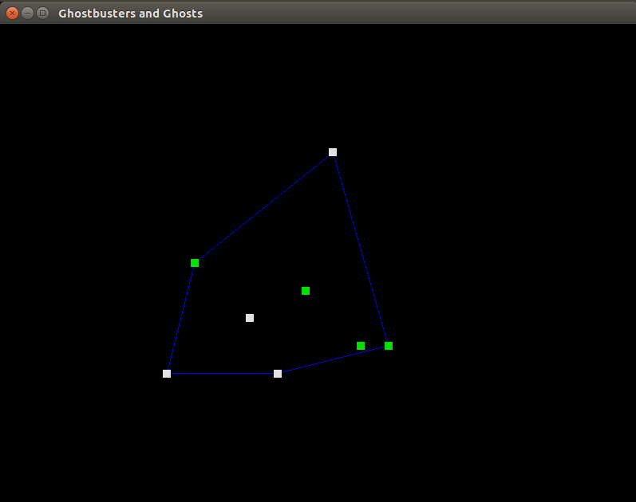

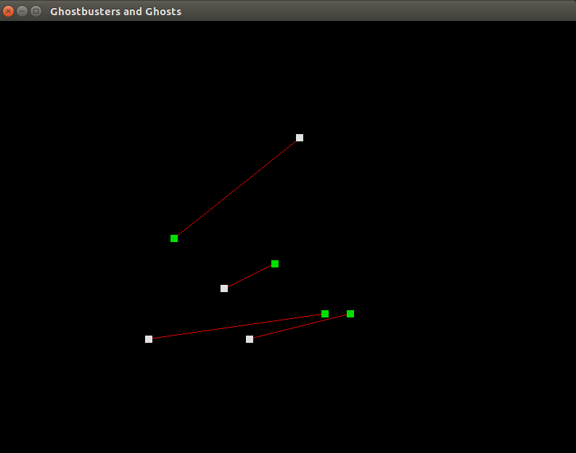
n = 4

Slide 15

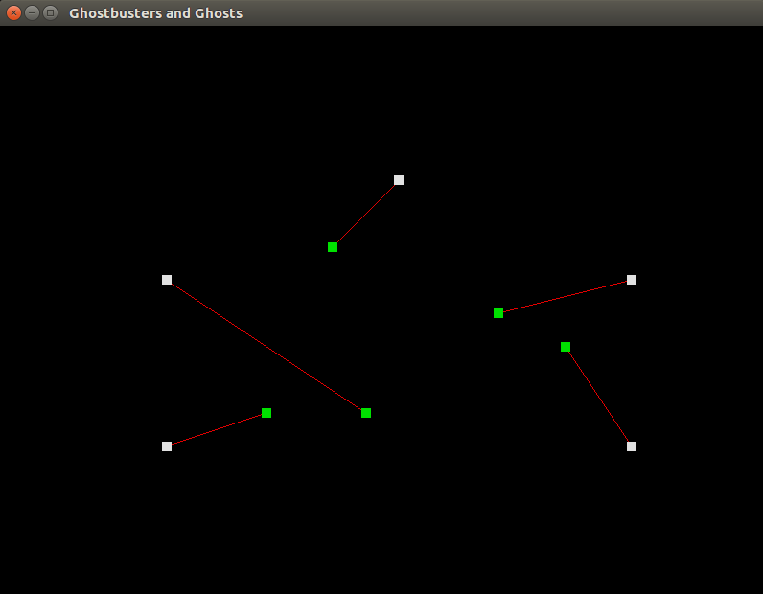

Completely Surrounded Case

Slide 16
Pseudocode and (Worst Case) Analysis
findPairs(busters, ghosts, n) pairs <- new vector of pairs if (n == 1) push back to pairs <- (0,0) else line <- findLineThread(busters, ghosts, n) push back to pairs <- line if (n == 2) push back to pairs <- the other pair not chosen by line else busters <- busters – line ghosts <- ghosts – line bustersCW <- the busters that are clockwise from the line ghostsCW <- the ghosts that are clockwise from the line bustersCCW <- busters – bustersCW ghostsCCW <- ghosts – ghostsCW concatenate to pairs <- findPairs(bustersCW, ghostsCW, size of bustersCW) concatenate to pairs <- findPairs(bustersCCW, ghostsCCW, size of bustersCCW) return pairs
// // C1 // C2 // C3 // // nlgn // C3 // C1 // C3 // // n // n // n // n // n // n // ? // // ? // // C4

Slide 17
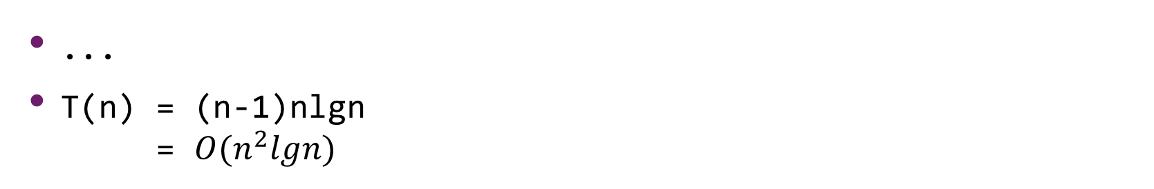
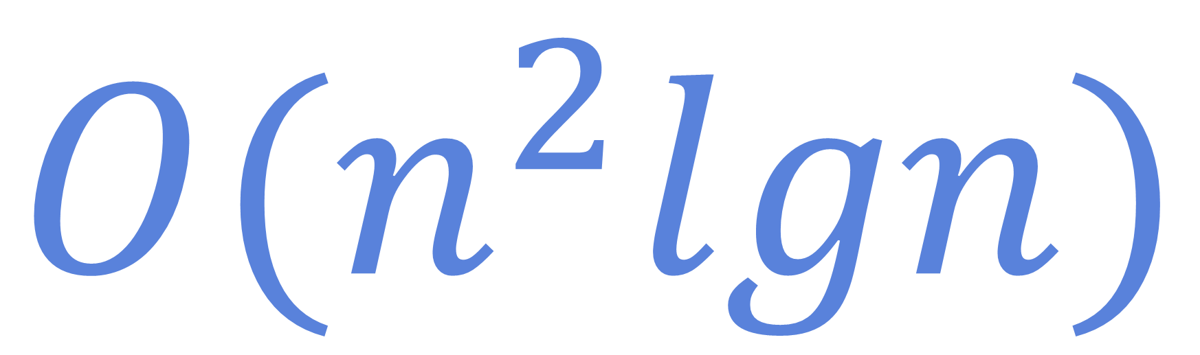
(Worst Case) Analysis
T(1) = C1 + C2 + C3 + C4 -> C
$$O(n^{2}lgn)$$
T(2) = C1 + C2 + nlgn + C3 + C1 + C3 + C4 -> nlgn
T(3) = C1 + C2 + nlgn + C3 + C1 + 6n + T(2) + C4 = 2C1 + C2 + nlgn + C3 + 6n + nlgn + C4 = 2C1 + C2 + 2nlgn + C3 + 6n + C4 -> 2nlgn
...
T(n) = (n-1)nlgn = $O(n^{2}lgn)$

Slide 18
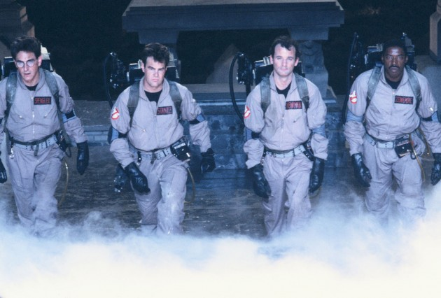
Thank you! Questions?
github.com/lampshadeq/csci174

